Slide 1
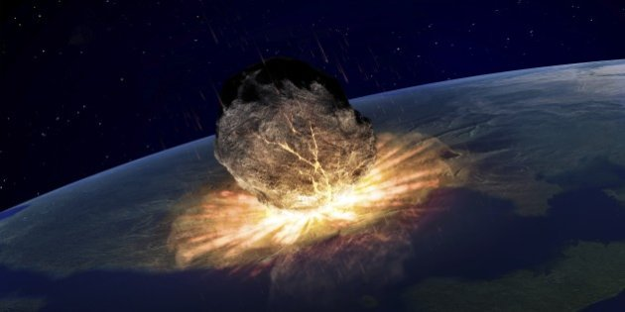
THE SUDBURY
DEPOSIT

Slide 2
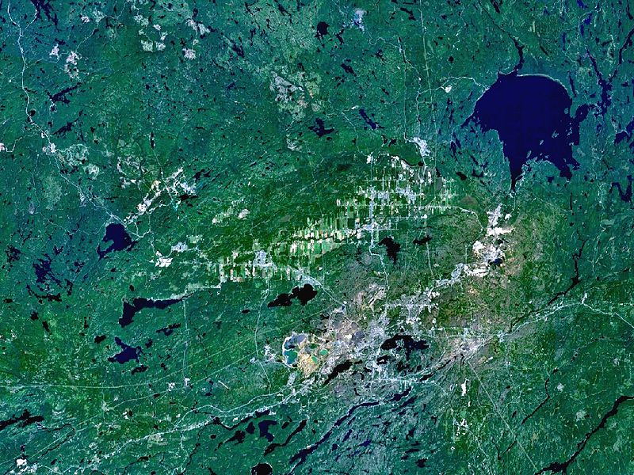
Introduction
The Sudbury Basin, also known as Sudbury Structure or the Sudbury Nickel Irruptive, is a major geological structure in Ontario, Canada.
The unique copper-nickel ore area in Canada (State of Ontario). Includes 61 deposits and mineralization. Mineralization is revealed in 1883, development of deposits with 1888, intensive production since 1904.
NASA World Wind satellite image of the Sudbury Basin

Slide 3
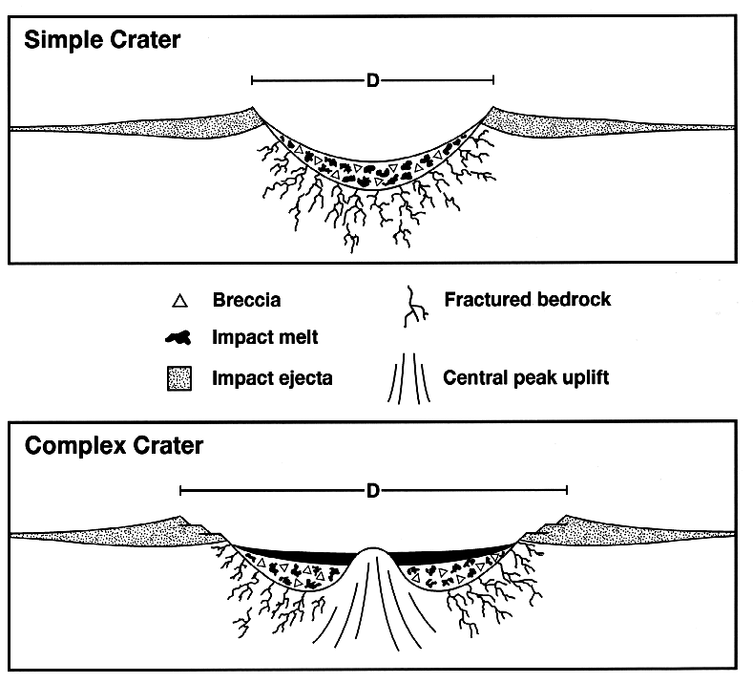
Formation
The Sudbury basin formed as a result of an impact into the Nuna supercontinent from a bolide approximately 10-15 km in diameter that occurred 1,849 million years ago in the Paleoproterozoic era.
Models suggest that for such a large impact, debris was most likely scattered globally, but has since been eroded away. Its present size is believed to be a smaller portion of a 250 km round crater that the bolide originally created. Subsequent geological processes have deformed the crater into the current smaller oval shape. Sudbury Basin is the second-largest crater on Earth

Slide 4
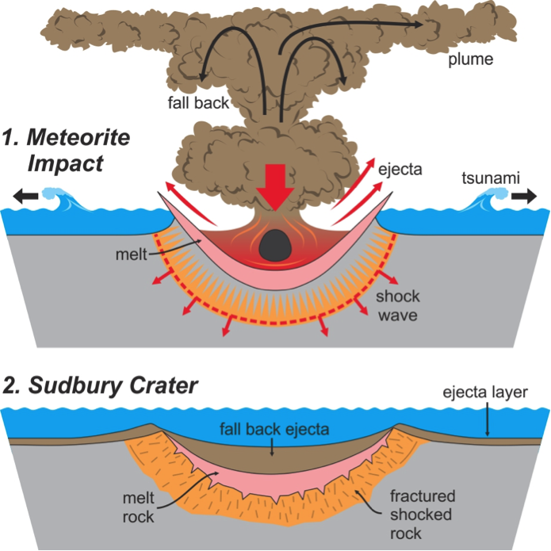
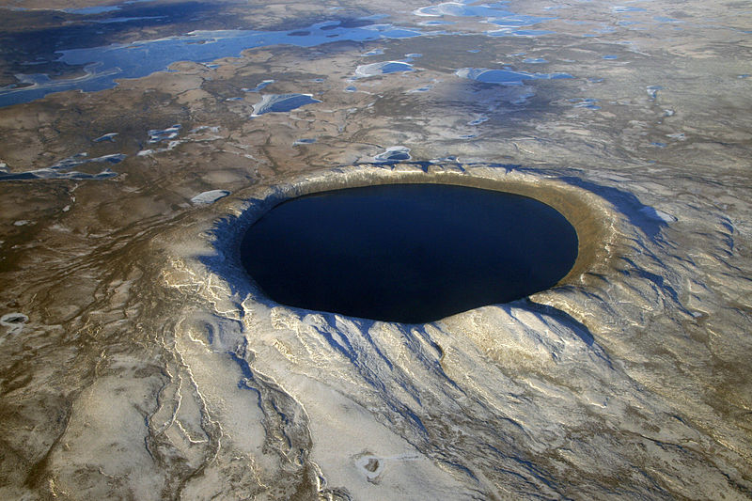
Formation
Pingualuit crater in Nunavik, northern Quebec, Canada, looking west.
It contains a lake named Lake Pingualuk.

Slide 5
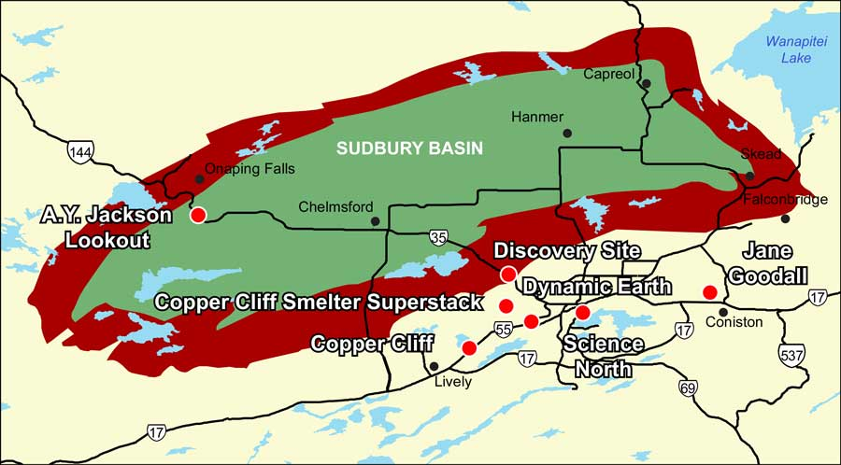

Slide 6
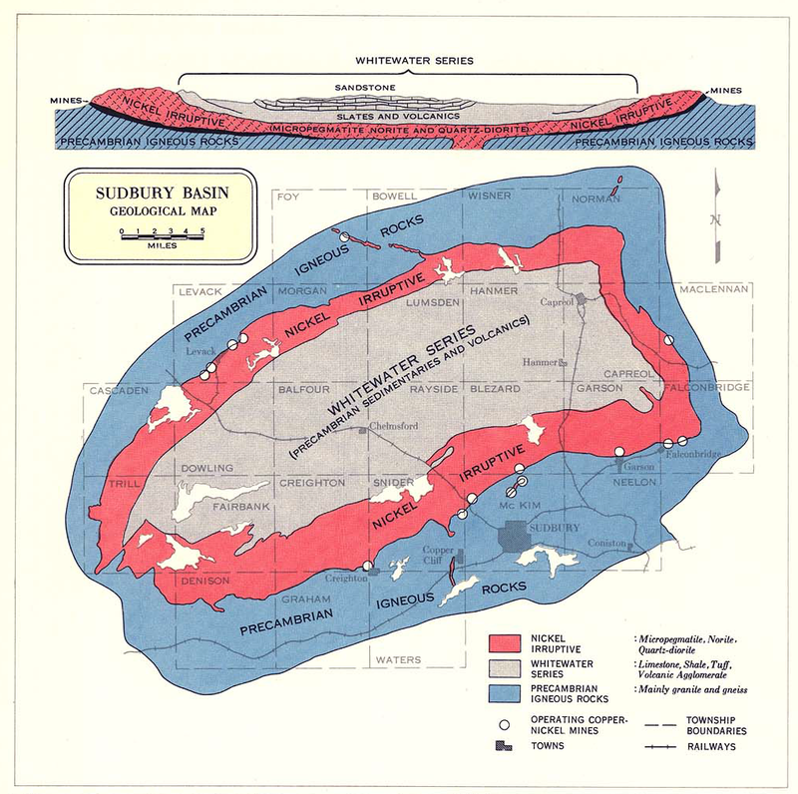
Structure
The full extent of the Sudbury Basin is 62 km long, 30 km wide and 15 km deep, although the modern ground surface is much shallower.
The main units characterizing the Sudbury Structure can be subdivided into three groups: the Sudbury Igneous Complex (SIC), the Whitewater Group, and footwall brecciated country rocks that include offset dikes and the Sub layer. The SIC is believed to be a stratified impact melt sheet composed from the base up of sub layer norite, mafic norite, felsic norite, quartz gabbro, and granophyre.
The Whitewater Group consists of a suevite and sedimentary package composed of the Onaping (fallback breccias), Onwatin, and Chelmsford Formations in stratigraphic succession. Footwall rocks, associated with the impact event, consist of Sudbury Breccia (pseudotachylite), footwall breccia, radial and concentric quartz dioritic breccia dikes (polymict impact melt breccias), and the discontinuous sub layer.

Slide 7
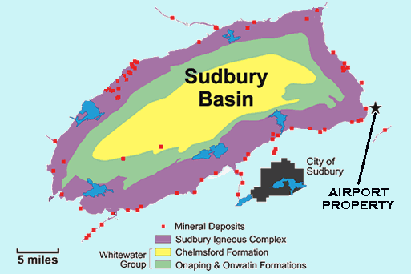
Rocks
The area is put by gneisses and migmatite of archaean age, volcanogenic and sedimentary rocks of the lower Proterozoic. Proterozoic rocks carry out the sinklinalny deflection on the archaean basis complicated by a large regional break of the subwidth pro-deleting. The ore-bearing difficult differentiated intrusive Sudbury array, by a secant of rock of the Archean and the lower Proterozoic is dated for a regional part of a deflection.

Slide 8
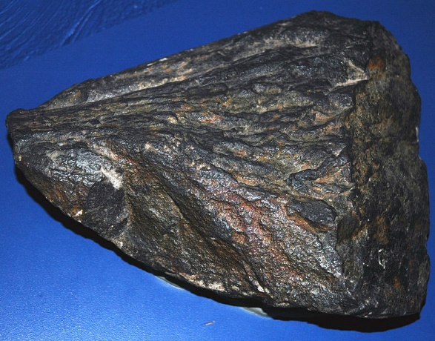
Rocks
The lower part of an intruziv is put by varieties of norite and gabbro, upper - micropegmatites. The structure of an array is complicated by gaps. Ore deposits are located on the periphery of an array: in a ground part - the poor interspersed ores, on contact of norite with the containing rocks and among last - rich ores of the massive, breccia, streaks and interspersed texture.
The sizes of ore bodies are various, some of them reach on extension and falling several hundred meters, seldom first kilometers at the power from the first meters to 120 m. A part of ore deposits is traced on depth up to 2000 m and more. Principal ore minerals: pyrrhotine, pentlandite, chalcopyrite also kubanit; the minor - magnetite, ilmenite, nikelisty pyrite, gersdorfit, nickeline, maukherit, hizlevudit, bornite, valleriit, etc.
Shatter cone from Sudbury
Impact Structurea deflection

Slide 9
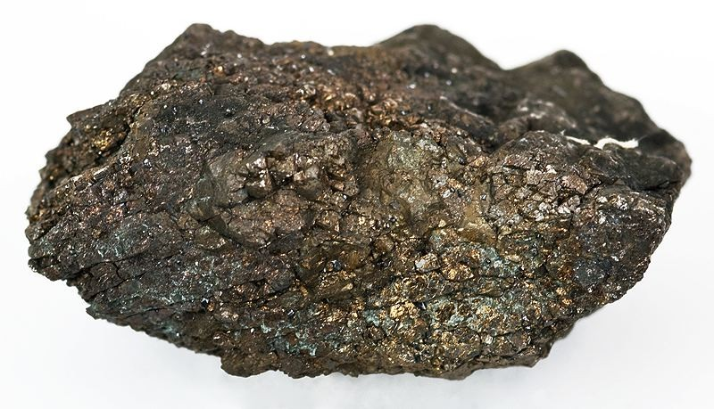
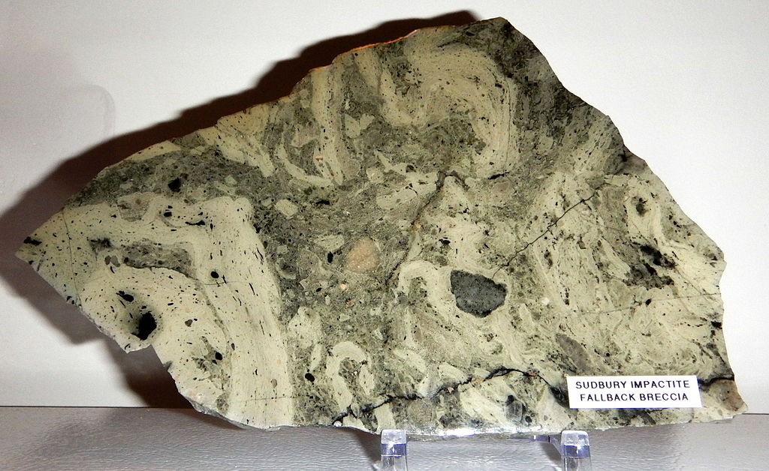
Rocks
Rich ore sample from Sudbury, collected in 1932: Pentlandite-Chalcopyrite-Pyrrhotite
Onaping Fallback Breccia, polished slab, 15 by 23 cm

Slide 10
The reserves
The total general reserves of ore around 487 million t (1987) including confirmed to 305 million t at average content in Ni ores of 1,2-1,7%, Cu of 0,7 - 1,5%. Besides, ores contain cobalt (to 0,12%), gold (up to 0,2 g/t), silver (6-8 g/t), metals of platinum group (up to 0,8 g/t), selenium and tellurium (only 11 accompanying elements taken in passing). The Stratkona deposit which ores contain up to 3,36% of copper, 0,88% of nickel and up to 28,35 g/t of silver differs in composition of ores.
From ores of Sudbury produce the refined nickel (content of nickel of 99,74%), nickel oxides (76% of nickel, 0,75% of copper), nickel-copper matte (about 40% of nickel), the refined copper and cobalt, gold, silver, metals of platinum group, selenium, tellurium, the concentrated sulfuric acid, the liquefied SO2, iron ore.

Slide 11
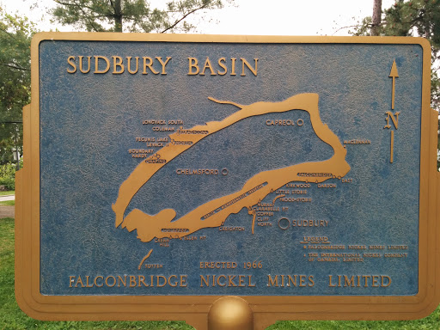
Thank you for your attention!

